Slide 1
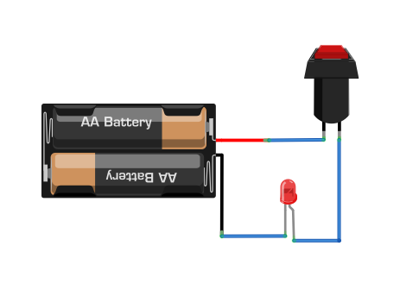
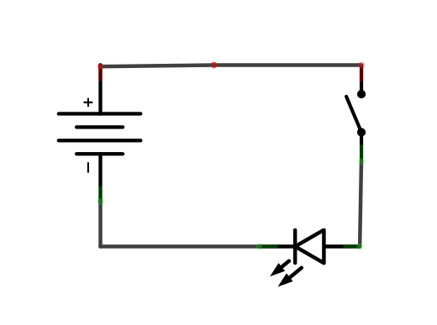
Basic Circuit
A circuit is the circular path that electricity flows through

Slide 2
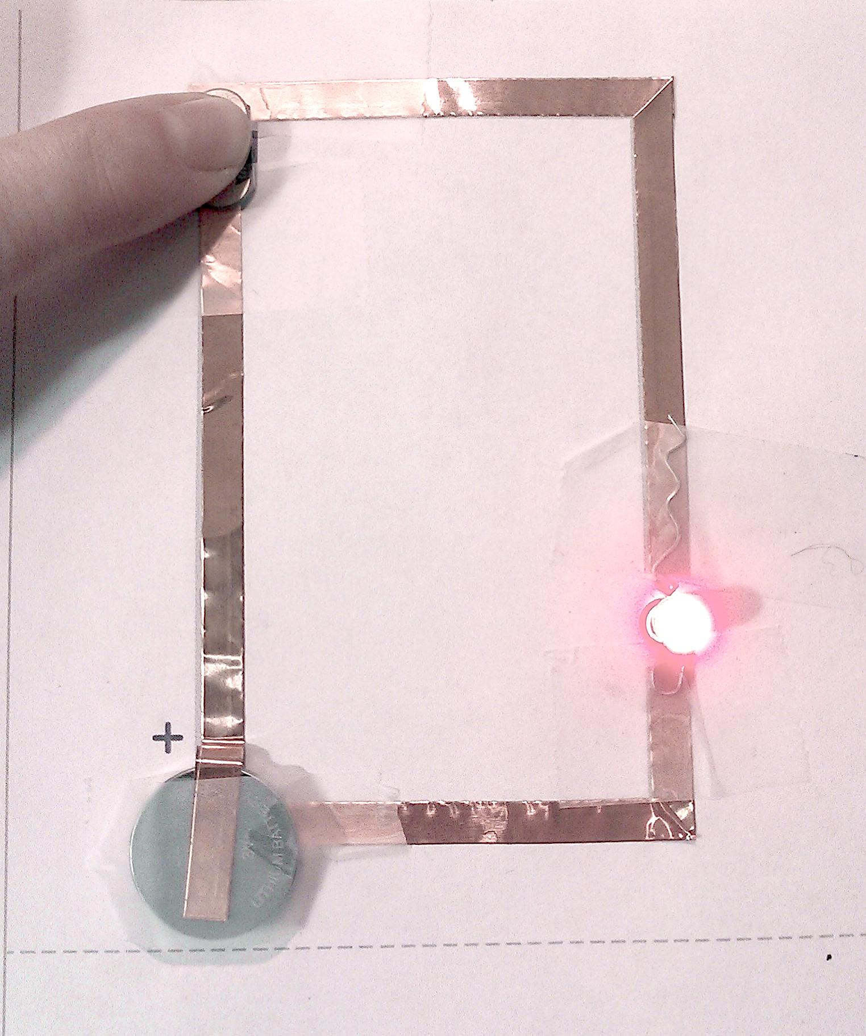
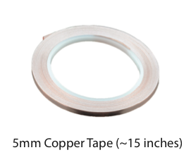
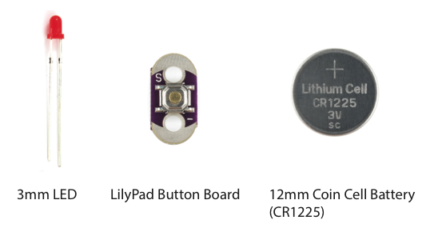
An example completed paper circuit
Supplies:

Slide 3
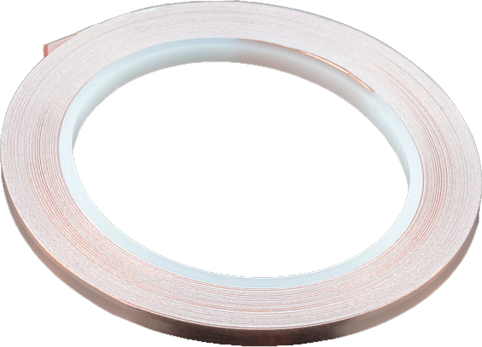
About Copper Tape
Pros:
Nice and conductive!
Peel and stick
Can use conductive paint to attach components to it
Can solder components to it
Cons:
Needs a continuous line so you must get creative when turning corners
Adhesive is NOT conductive
Can have sharp edges so be careful!

Slide 4
Turning corners with the copper tape
FOLD FORWARD
FOLD
DONE!
It’s okay if your fold isn’t perfect — we just want to go around the corner without the tape breaking

Slide 5
Joining tape in case of breaks/tears
Overlap top side to top side
FOLD BACK
BREAK
FOLD
1/2 AGAIN
JOINING PIECE
Join pieces by touching the TOP SIDE of the copper tape to the TOP SIDE of each section
Secure with clear tape

Slide 6
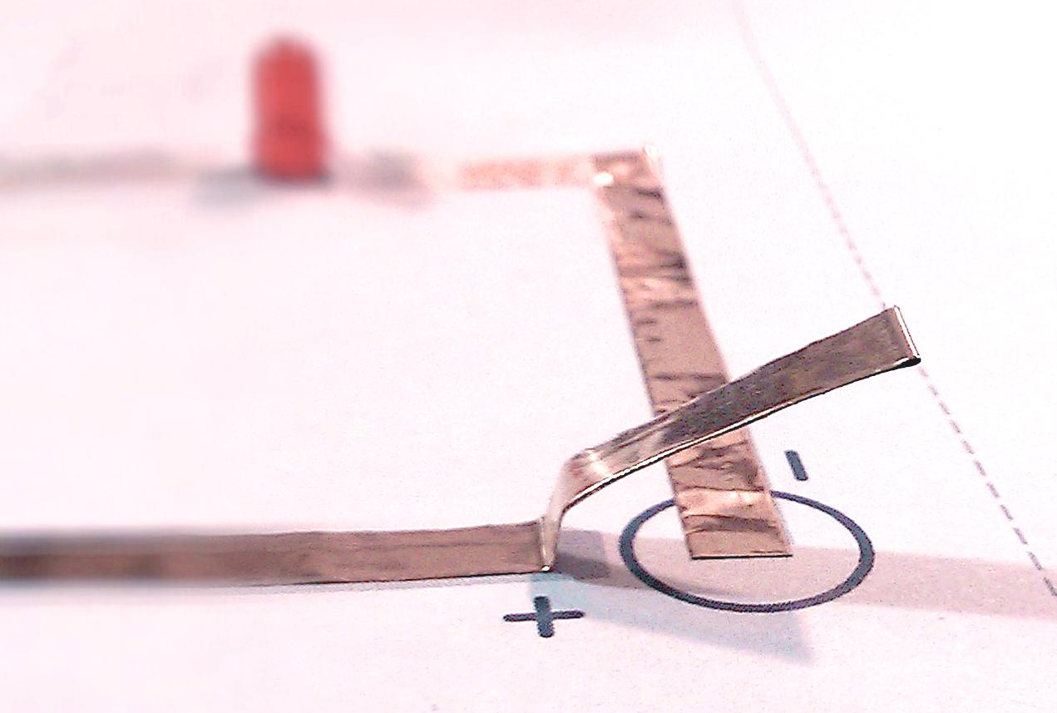
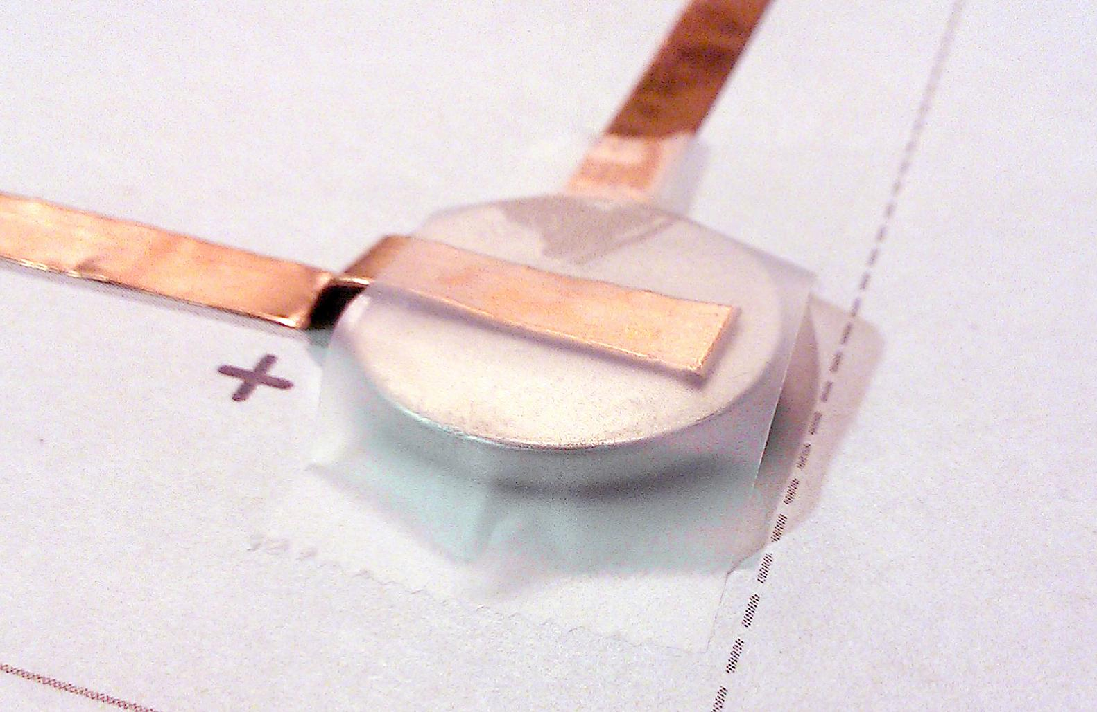
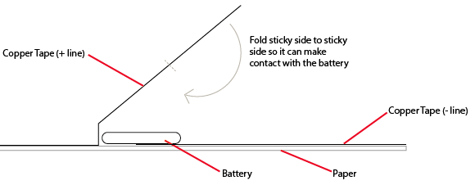
Making a Battery Holder
The side with the labels/writing is the top of the battery.

Slide 7
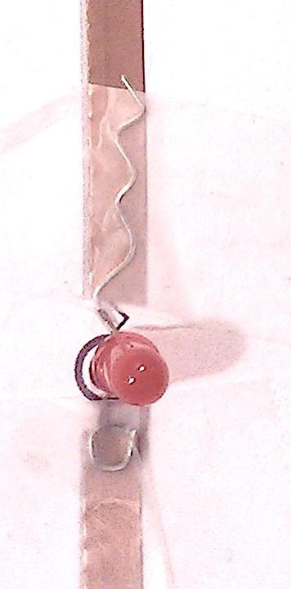
LEDs
Use clear tape to stick the LED to the copper tape
Make sure the + and - are aligned correctly

